Slide 1

Mobile Security Threats & Solutions
Protecting Your Mobile Device and Data
Presented by
Suresh kumar
BCA 3rd Sem
Submitted to
BCA Department

Slide 2

Introduction
Mobile security refers to protecting mobile devices, data and application.
Mobile devices store sensitive information.
70% of online threats target mobile devices
50% of organizations experienced mobile security breaches

Slide 3
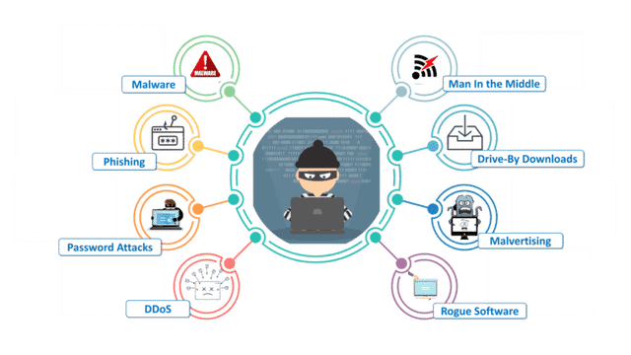
Top Mobile Security Threats

Slide 4

Malware Threats
Malicious software harming mobile devices.
Ex Viruses, Trojans, Ransomware
99% of mobile malware targets Android devices (Kaspersky)

Slide 5

Prevention Measures
Use strong passwords and biometric authentication
Enable device encryption
Install antivirus software
Avoid suspicious downloads and links
Verify sender identify

Slide 6
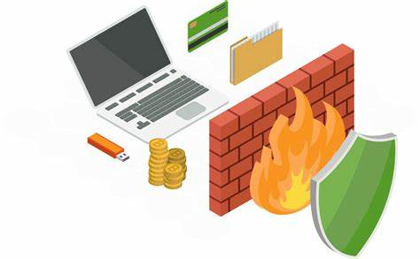
Mobile Security Solutions
Antivirus software
Firewall
Encryption
Mobile Device Management (MDM)
Secure browsing and email clients

Slide 7


Best Practices and Conclusion
Best Practices:
Regularly update and patch devices
Use secure Wi-Fi networks
Disable Bluetooth when not is use
Conclusion:
Awareness and proactive measures can prevent mobile security threats.

Slide 8
THANK YOU

